Slide 1
Analyzing the severity of car accidents
By:
T . Srujana

Slide 2
Synopsis
Problem Description
Traffic accidents represent one of the leading causes of death worldwide and of economic expenditure. Despite the numerous measures and campaigns that are deployed every year to raise awareness of the seriousness of the problem, it still occurs quite frequently. The impact of road accidents on society and the economy is high, and human losses are compounded by large expenditures on health care, awareness campaigns, mobilization of specialized personnel, etc. Collaboration to reduce these losses has become an important issue of general interest.
Defining the problem:
What are the factors that have a high impact on road accidents?
Is there a pattern to them?
Correlation?
We will have to analyze the data to get a clearer picture and draw conclusions.

Slide 3
Synopsis
Introduction
Note that this work represents the final project of the IBM certification course, for which we have provided the data with which we will develop the project.
These data have been collected and shared by the Seattle Police Department (Traffic Records) and are provided by Coursera for downloading through a link.
It takes into account a period of time from 2004 to the present, recording information related to the severity of the traffic accident, location, type of collision, weather and road conditions, visibility, number of people involved, etc.
The objective is to define the problem, to find the factors that can have a relevant weight in the quantity and seriousness of the accidents, so that any organism, company or enterprise interested in reducing these figures, can focus the resources in points where these conditions converge.
In order to provide greater clarity, I will try to analyze the data, see if there are relationships or patterns, especially in high impact accidents, so that preventive measures can focus on these points as a first prevention strategy.

Slide 4
Synopsis
Data to be used
For an accurate prediction of the magnitude of damage caused by accidents, they require a large number of reports on traffic accidents with accurate data to train prediction models. The data set provided for this work allows the analysis of a record of 200,000 accidents in the state of Seattle, from 2004 to the date it is issued, in which 37 attributes or variables are recorded and the codification of the type of accident is allowed, grouped according to 84 codes. The information can be extracted from it:
Speed information
Information on road conditions and visibility
Type of collision
Affected persons, etc
The data will be used so that we can determine which attributes are most common in traffic accidents in order to target prevention at these high-incidence points.

Slide 5
Synopsis
Data Source
Data Source: These data have been collected and shared by the Seattle Police Department (Traffic Records) and are provided by Coursera for downloading through a link.
Data Location: Coursera_Capstone/Data assets
Data set name: Data-Collisions.csv

Slide 6
Methodology
Objective:
The objective of this project is to predict the severity of a traffic accident based on the other characteristics contained in the report.
Packages and libraries:
We will use libraries and packages for both data manipulation and data visualization. PANDA , NUMPY , SCIPY , Matplotlib , Seaborn.
A data analysis will be performed in order to determine what type of methodology and learning of the machine will be the most appropriate , in addition to obtaining a first contact with the data that we find more relevant to use in this project.

Slide 7
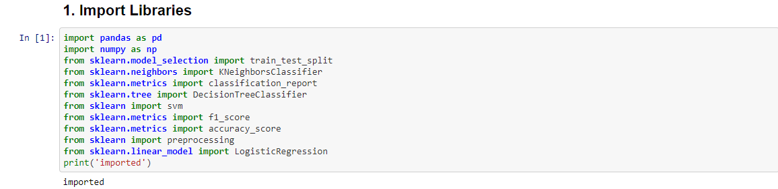
Data Analysis
PART- 1 : Importing libraries & Getting the records of accidents in the state of Seattle
Importing Libraries:
Imported libraries required for the project

Slide 8
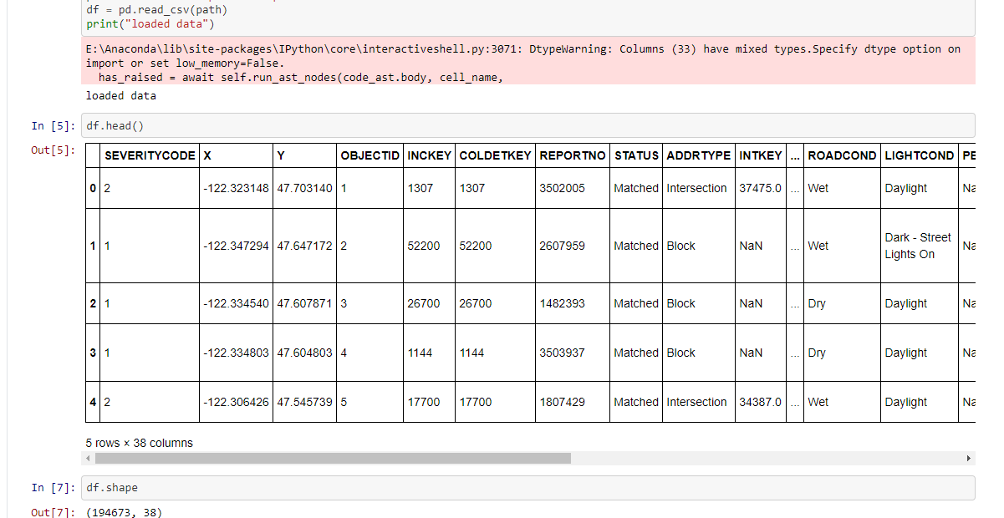
Data Analysis
PART- 1 : Importing libraries & Getting the records of accidents in the state of Seattle
Getting the records :
For analyzing the car accidents severity we need data regarding the accidents . We will be getting this records of accidents in the state of Seattle using the csv file given for us in week 1 which is "Data -Collisions.csv". And we process the table.

Slide 9
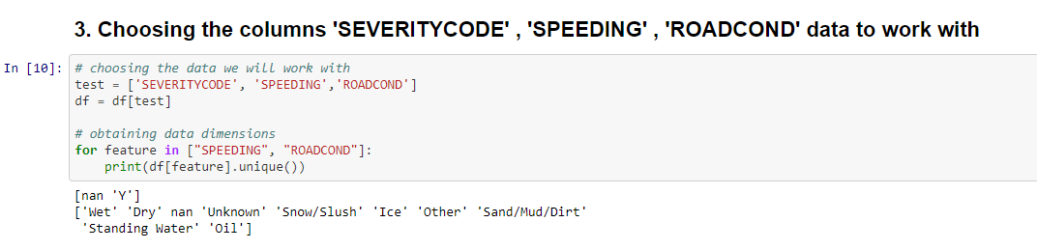
Data Analysis
PART-2 : Choosing the columns 'SEVERITYCODE' , 'SPEEDING' , 'ROADCOND' data to work with
Choosing the columns 'SEVERITYCODE' , 'SPEEDING' , 'ROADCOND' data:
For analyzing the car accident severity I choose the columns 'SEVERITYCODE' , 'SPEEDING' , 'ROADCOND' data from the data frame for working.

Slide 10
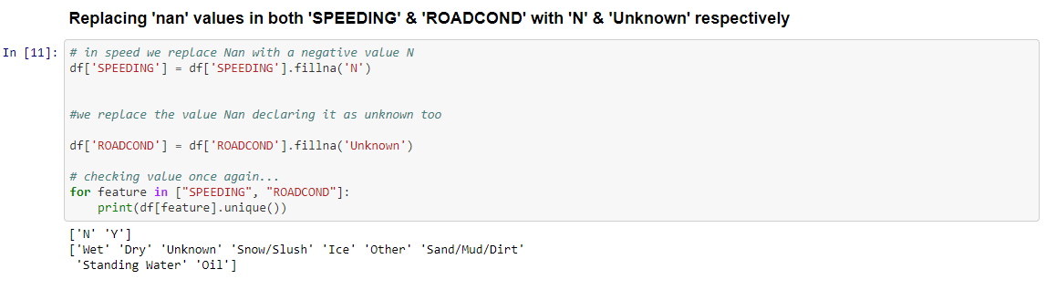
Data Analysis
PART-2 : Choosing the columns 'SEVERITYCODE' , 'SPEEDING' , 'ROADCOND' data to work with
Now we enter into processing of data and I processed data in this format
Replacing 'nan' values :
I Replaced 'nan‘ values in both 'SPEEDING' & 'ROADCOND' with 'N‘ & 'Unknown' respectively.

Slide 11
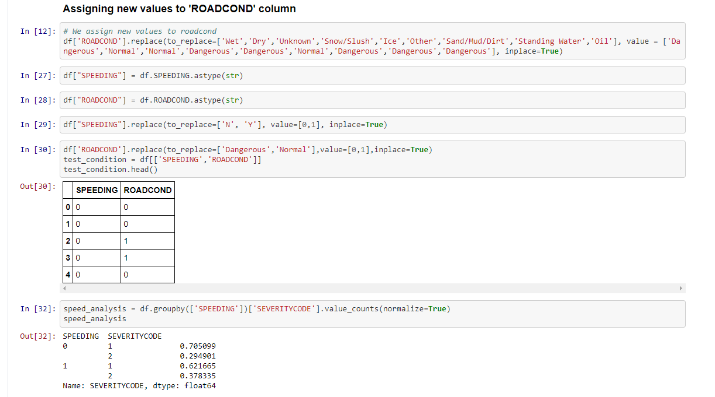
Data Analysis
PART-2 : Choosing the columns 'SEVERITYCODE' , 'SPEEDING' , 'ROADCOND' data to work with
Assigned new values & Created a “test_condition” data frame :
I assigned new values to the column 'ROADCOND' as 'Dangerous' or 'Normal'. I replaced the values of columns 'SPEEDING' with “0” and “1 “.I had done the same thing with the column 'ROADCOND' i.e., replacing the values . Now I took these two columns 'SPEEDING' &'ROADCOND' from the data frame to "test_condition“.

Slide 12
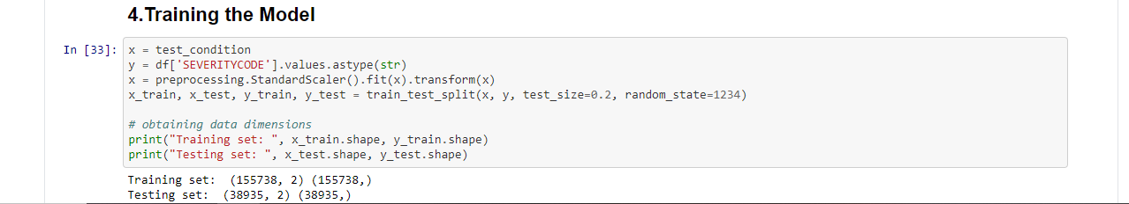
Data Analysis
PART-3 : Applying Machine Learning Techniques
As the dataset is fully ready to be used for Machine learning (and statistical analysis)
Purposes.
Firstly
Training the model :
I trained the model using the processed data frames.

Slide 13
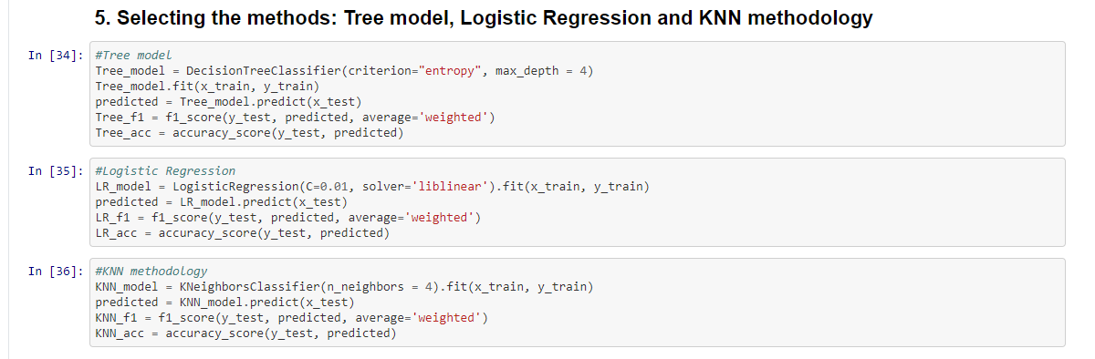
Data Analysis
PART-3 : Applying Machine Learning Techniques
I obtained f1-score and accuracy using the 3 models i.e., Tree model, Logistic Regression and KNN methodology(by choosing k value 4).

Slide 14
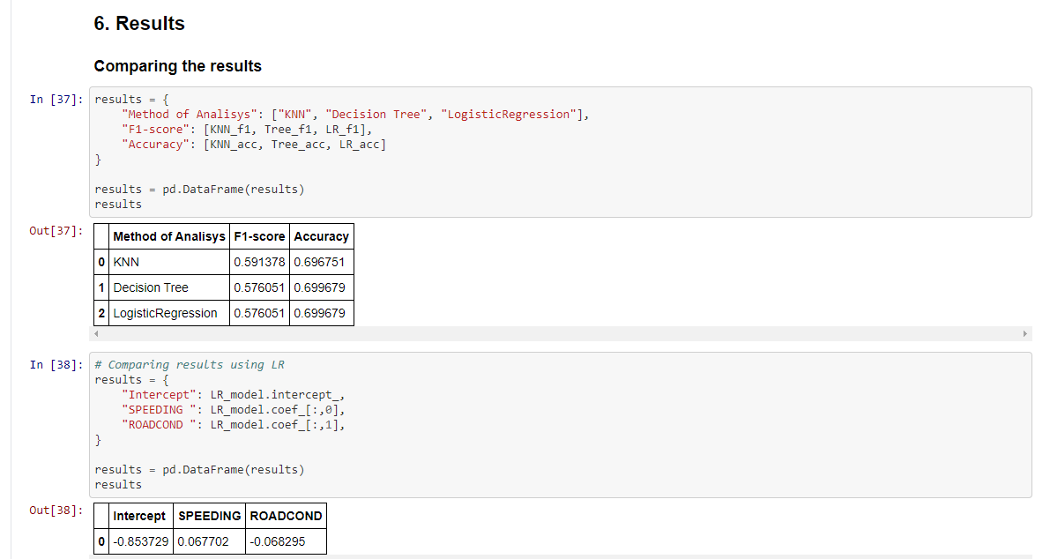
Decision Making and Reporting
I obtained the f1-score and accuracy of the 3 models as mentioned in the previous
slide. And I compared the result using LR .

Slide 15
Results
 | Method of Analysis | F1-score | Accuracy
0 | KNN | 0.591378 | 0.69675
1 | Decision Tree | 0.576051 | 0.699679
2 | LogisticRegression | 0.576051 | 0.699679
 | Intercept | SPEEDING | ROADCOND
0 | -0.853729 | 0.067702 | -0.068295
Looking at the results obtained in the comparison , it is understood that speed and road conditions influence the severity of traffic accidents.
According to the results of this method, the two attributes of the table have a determining influence on the increase of accidents , however more factors must be taken into account.

Slide 16
Conclusion and recommendations
Knowing that speed and road conditions are factors that influence traffic accidents and their severity , recommendations for reducing accidents could include
Limiting speed in areas where road conditions are worse
Surveillance and radar cameras -Maintain traffic control routes on these roads
Enable emergency exit areas and rescue stations
Improve the maintenance of these streets, signaling and lighting

Slide 17


